Slide 1


General Chemistry Labs
Al-Karkh University for Science
Collage of Science
Dr. Mohammed A. B. Abdul Jabar
Ph.D chemistry (Inorganic Chemistry)

Slide 2
Syllabus Labs Content
Subject | Lab. No.
General safety rules for Laboratory | 1
General Chemistry Equipment’s | 2
Preparation of standard solution | 3
Preparation of standard solution from liquid solutions | 4
Titration Strong Acid with Strong Base | 5
Titrating Sodium Carbonate with Hydrochloric Acid | 6
pH - metric Titration | 7
Conductometric Titration of Strong Acid with Strong Base | 8
Separation of I Group cations (Ag⁺, Pb²⁺, Hg₂²⁺) | 9
Titration of Acetic Acid in Vinegar | 10
Titration of a Mixture of Carbonate (CO₃²⁻) and Bicarbonate (NaHCO₃⁻) | 11
Identification of Ketones and Aldehydes | 12
Carbohydrates | 13
Silver nitrate titrations by (Mohr method) | 14
Final Exam | 15

Slide 3




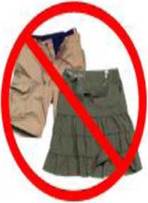

AlKarkh University of Science College of science Department of Microbiology
First year level
General chemistry Labs
Supervisor: Dr. Mohammed Abdul Baset Assistant: Anssam Dhaher Huessin
Lab -1-
General safety rules for Laboratory
1. DO NOT perform unauthorized experiments or work in a laboratory alone.
2. Approved eye protection must be worn at all times in the laboratory. Eye protection must be splash proof chemical goggles and be approved by your instructor. If you do get a chemical in your eye rinse immediately with large quantities of water using the eyewash stations.
3. Long hair and loose clothing must be confined while in a laboratory.
Tied-up hair (For long hair only)
Covered Shoes
No untied long hair
No Shorts/Skirts
No Open Toed Shoes
1

Slide 4
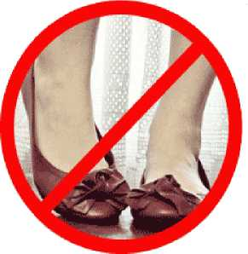


4. Appropriate clothing must be worn at all times while in the laboratory. Your legs must
be completely covered below the knee by your choice of clothing. If your clothing does not meet the requirement you may choose to wear an approved laboratory coat or apron which does cover your legs to your knees.
5. Closed shoes with socks must be worn at ALL times - opentoed shoes, backless shoes, sling backs, clogs, and sandals are not permitted.
6. Know the location and proper use of fire extinguishers, fire blankets, safety showers, eye wash devices, and first aid kits.
7. Before obtaining any chemicals carefully read the label on the reagent bottles.
8. Eating, smoking, and drinking are not allowed in a chemistry laboratory.
9. Thoroughly wash your hands after leaving the laboratory.
10. Use the fume hoods when toxic or irritating vapors are involved.
11. Mouth suction is never used to fill a pipette.
12. Never force glass tubing through cork or rubber stoppers without proper lubrication.
13. Never direct the open end of test tube toward yourself or anyone else.
14. Never pour water into concentrated acid.
15. Learn the proper procedure for igniting and operating a laboratory burner. Always extinguish the flame when the
burner is not being used. Make sure that all flammable reagents are well removed before lighting the burner.
16. Liquid and solid waste containers must be properly used at all times.
17. Never place chemicals directly on the balance pan. Always use a proper weighing container when using a balance to weigh a chemical. Never pour chemicals directly over the balance.
18. Never return unused chemicals to their original container (unless directed to do so by the instructor).
2

Slide 5

19.Securely replace lids, caps, and stoppers after removing reagents from containers.
20. Always wipe spatulas clean before and after inserting into reagent bottles.
21. Report any accident and/or injury, however minor, to your instructor immediately.
22. Never place anything that is not directly required for the experiment on laboratory desks; other items may interfere with the experiment.
23. All personal belongings should be placed in the bookcases as you enter the laboratory.
24. Clean up any spill immediately.
25. Before leaving the laboratory, make sure your work area is clean and dry. Ensure that all gas, water, vacuum, and air valves are completely turned off.
26. Your instructor is available for any assistance you may need. Never hesitate to ask questions especially if there is any question concerning proper operating procedure. Be sure that you understand every instruction before proceeding.
3

